Slide 1

CPRG 210 Web Application Development
Module 2: Forms, Semantic Elements & Introduction to CSS

Slide 2
Outlines
HTML Forms
HTML Sectioning/Semantics Elements
Introduction to CSS
Adding CSS to HTML (Inline, on page, external file)
General Syntax, Selectors, and CSS Rule
Resolving conflicting CSS Rules
Styling Examples

Slide 3
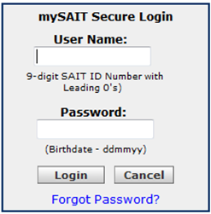
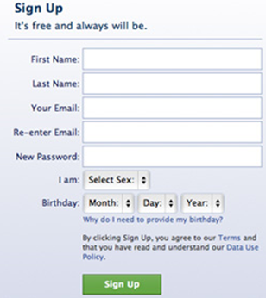
HTML Forms: Concepts
An Area Containing Form Elements.
Gathering/Accepting User-Entered Information that can be Processed.
Created using <FORM>.
Form Examples
Account Registration | Contact-Us | Sign/log in | Reservation/Order
Text Box
Password
Button

Slide 4
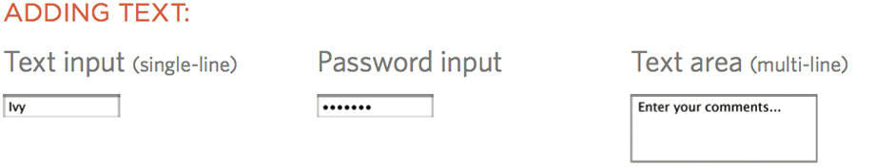
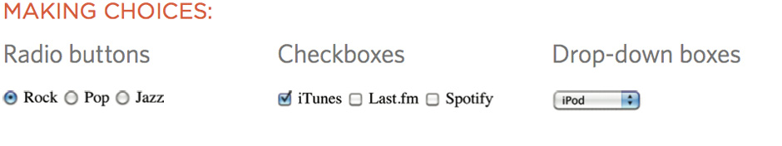
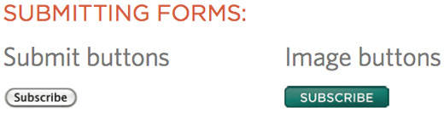
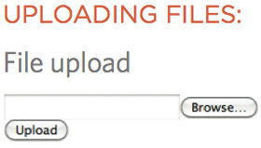
Form Elements/Controls/Fields
Gathering Input
Selection
Clickable Buttons

Slide 5
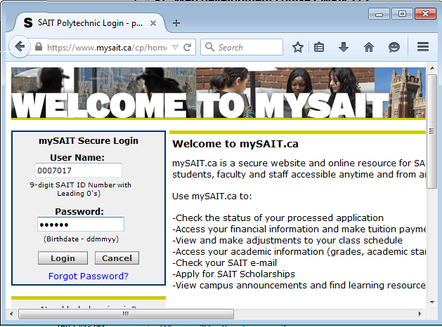
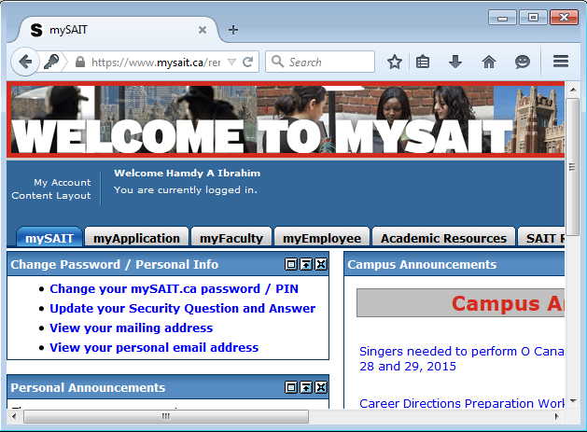

How HTML Forms Works?
1. User fills in form
2. User presses button to submit info to server
Server
4. Processing and sending the page
3. Name of each form control sent with the value entered by the user

Slide 6
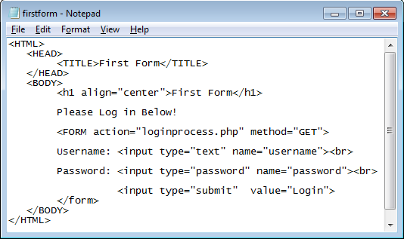
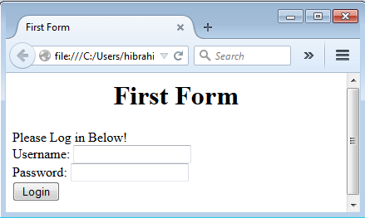
Simple HTML Form: Example
<form>Form Elements</form>
Elements/Controls/Fields

Slide 7
HTML <FORM> Tag
Action: Where to Send Form Data?
<FORM> Tag: Attributes
Method: How Form Data is Sent?
Target: Where to Open Page Sent by a Server
Form Data is Sent to php file
7

Slide 8
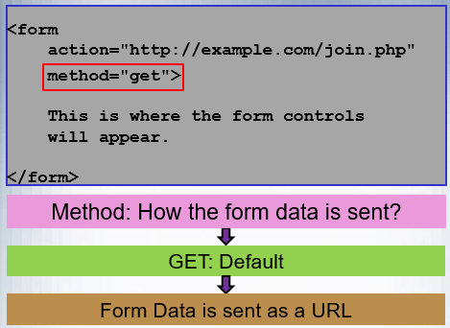
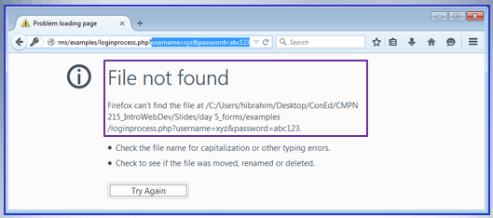
HTML <FORM> Tag
8

Slide 9
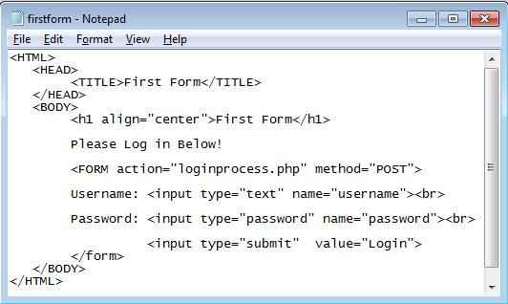
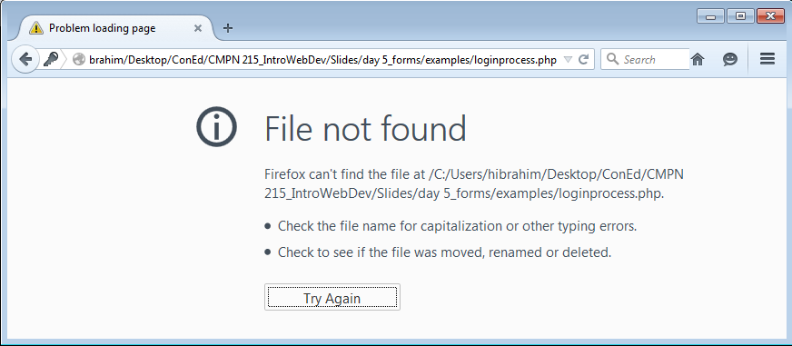
HTML <FORM> Tag
Method=“POST”
Form Data is sent within URL
9

Slide 10
HTML Forms <INPUT> Tag
<INPUT>
Create Most, but Not All Elements
Type: Text, Password, Button, etc.
Name & Value Attributes
Readonly Attribute
Disabled
10

Slide 11
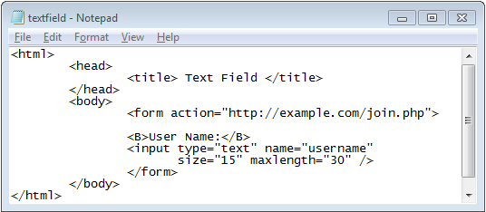
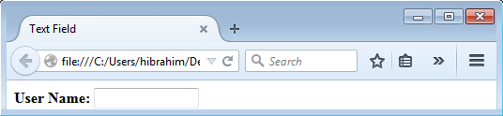
Forms Elements: Text Field
<input type=“text” />
Enable Users to Type Text
How big is the text box?
Max # of Characters
Bold Label
11

Slide 12
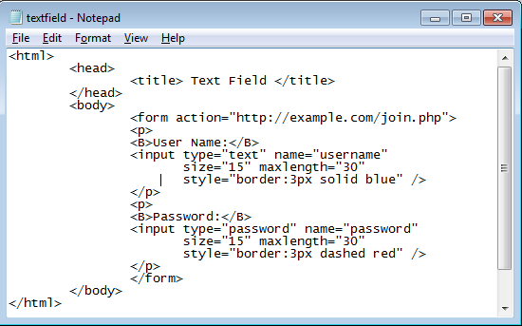
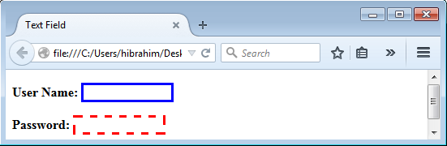
Forms Elements: Password
<input type=“password” />
Typed Characters are Masked
CSS: style
Spaces in Between
12

Slide 13
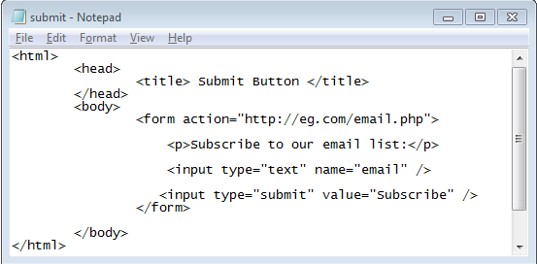
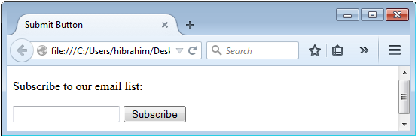
Forms Elements: Submit Button
<input type=“submit” />
Clickable/Send Form Data to a Server
Data is Sent to the Page Referenced in Action
13

Slide 14
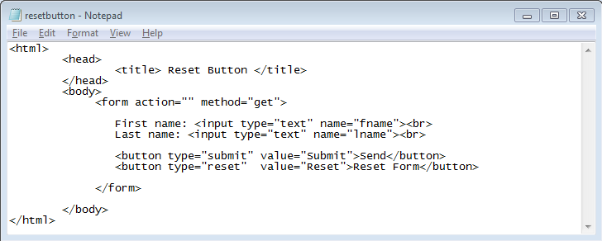
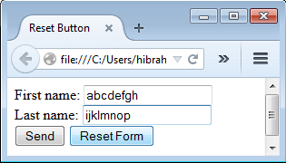
Forms Elements: Reset Button
Creating Buttons using <button>
Reset Form Data to Its Initial Values
<input type=“reset” />
14

Slide 15
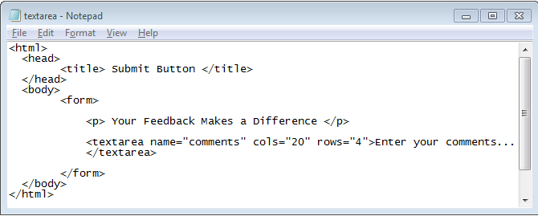
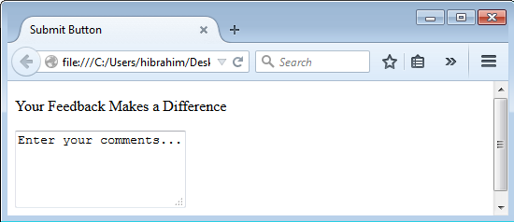
Forms Elements: Text Area
Multiline Text Field
No. of Rows
Text Area Width
15

Slide 16
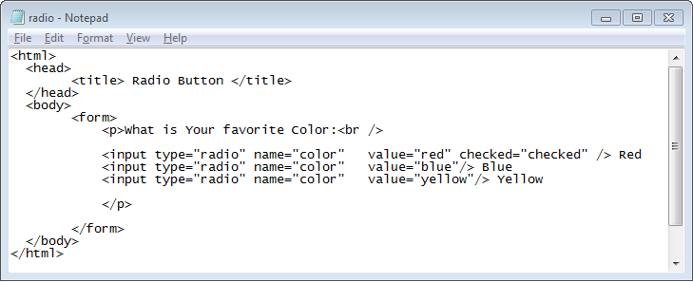
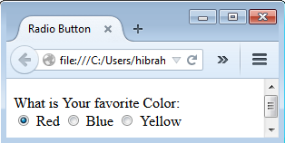
Forms Elements: Radio/Option Button
User Can Choose Only One Option
Horizontal Radio Button
<input type=radio”…..>
16

Slide 17
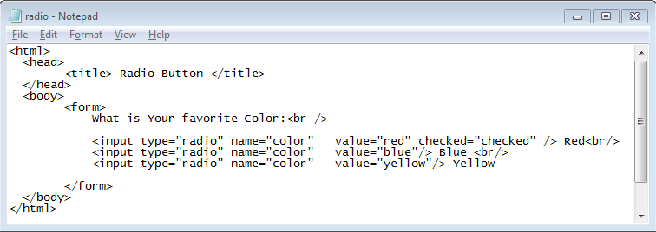
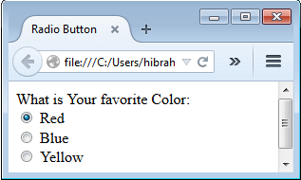
Forms Elements: Radio/Option Button
Vertical Radio Button
17

Slide 18
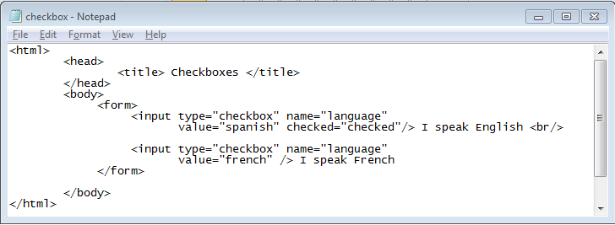
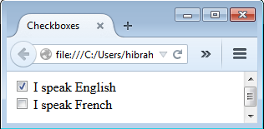
Forms Elements: Checkbox
Use Select One or More Options
<input type=“checkbox”/>
18

Slide 19
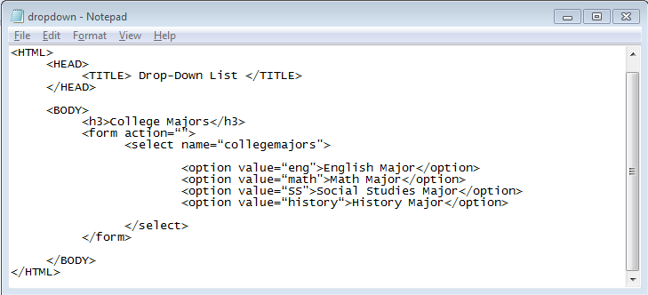
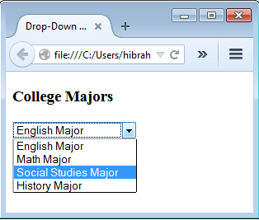
Forms Elements: Drop-Down List
Having Several Options
Used to Select One Option or More
<select>
<option>
19

Slide 20
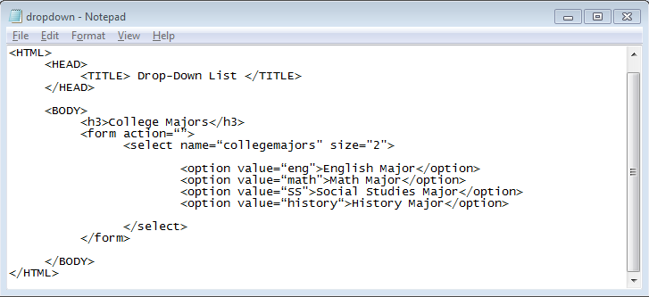
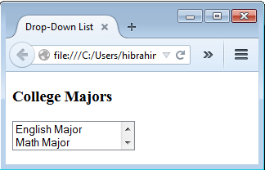
Forms Elements: Drop-Down List
Size: No. of visible items
Default: 1
2 Visible Items
20

Slide 21
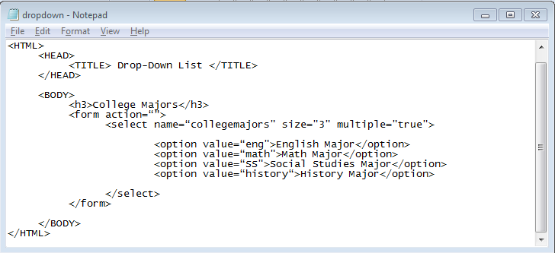
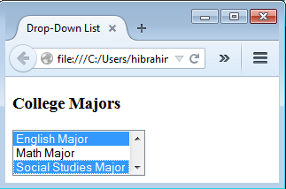
Forms Elements: Drop-Down List
Multiple: Enable Multiple Selection
Default: False
3 Visible Items
21

Slide 22
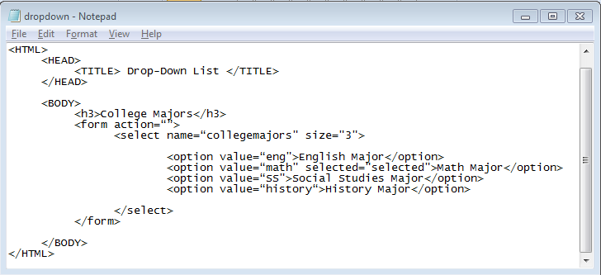
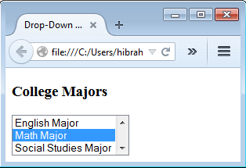
Forms Elements: Drop-Down List
selected: which item is initially selected
2nd Option is initially selected
22

Slide 23
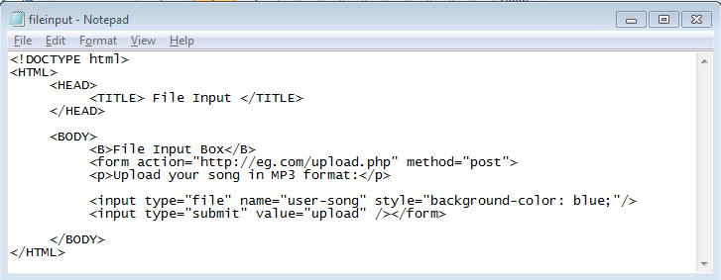
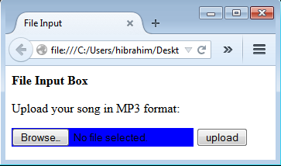
Forms Elements: File Input Box
23

Slide 24
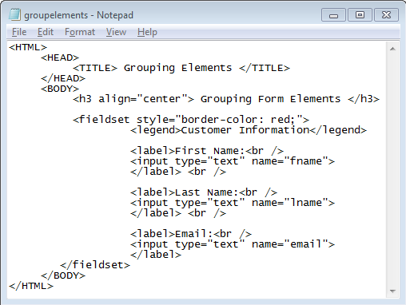
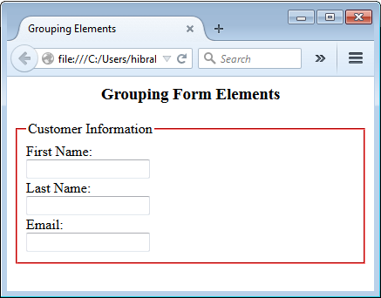
HTML Forms: Grouping Elements
24

Slide 25
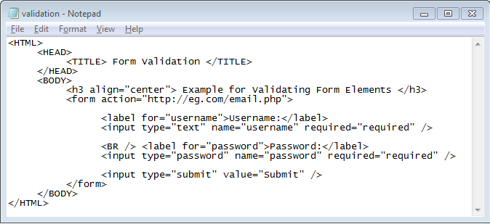
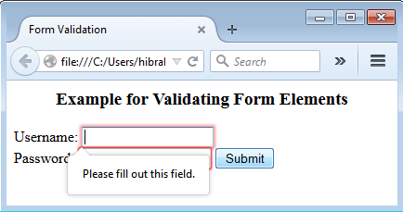
Forms Elements: Form Validation
Validation using required attribute
25

Slide 26
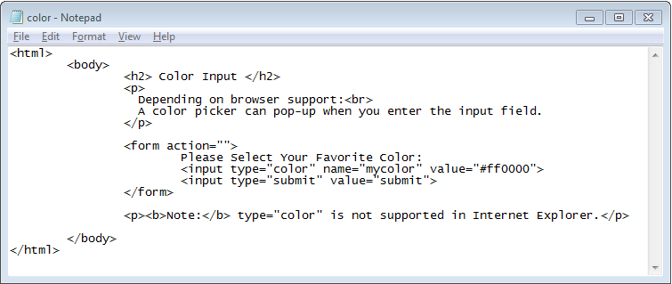
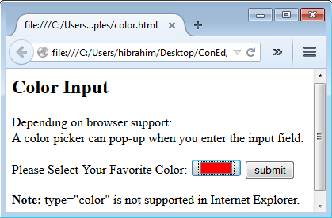
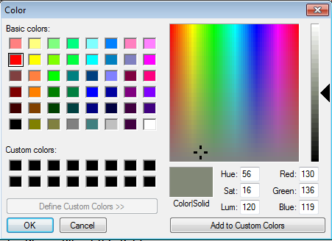
Forms Elements: Color Input
Initial Color: Red
26

Slide 27
HTML 5 Input Types
Color | Date |  | Email
Month | Number |  | Range
Search | Tel |  | Time
url |  | Week
http://www.w3schools.com/html/html_form_input_types.asp
http://www.w3schools.com/tags/att_input_type.asp
Recommendations for best practices in coding
http://www.w3schools.com/html/html5_syntax.asp
27

Slide 28
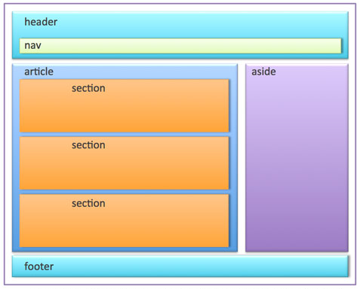
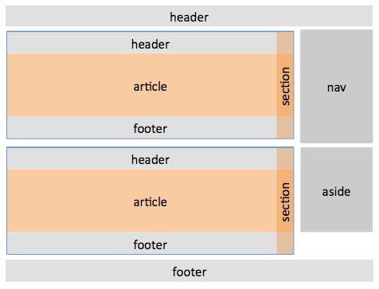
Sectioning/Semantic Elements
Dividing Webpage into Sections/Regions/Divisions/Areas
Easy To Structure & Style Webpage
More Semantic Meanings: Browsers Better Understand Content
28

Slide 29
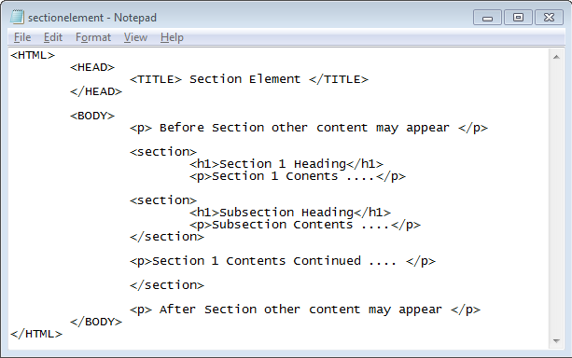

Section Element: Example
Semantic: Compare Section & Subsection Headings

Slide 30


Aside Element Example
Styling using tag name “body”
CSS is very important

Slide 31


DIV Element Example
Styling using tag name “li”
Styling is very important

Slide 32
HTML 5 Sectioning Elements
<mark>
<nav>
<section>
<summary>
<time>
Semantic Web
<article>
<aside>
<details>
<figcaption>
<figure>
<footer>
<header>
<main>
http://www.w3schools.com/html/html5_semantic_elements.asp
http://www.w3schools.com/html/html_layout.asp
Resetting Styles
http://meyerweb.com/eric/tools/css/reset/
http://code.tutsplus.com/tutorials/weekend-quick-tip-create-your-own-resetcss-file--net-206
At this point you probably realize that HTML5 is very dependent on CSS, so let’s have a look at it so we can combine the two…

Slide 33


ID Attribute
Uniquely Identify HTML Element
Used by CSS and Javascript
ID Selector: #ID_Name
Same ID should be used with only one element
ID value begins with A-Z Letter or _
Followed by letters and digits
Case sensitive (me != Me)

Slide 34



Styling Using ID
Add Footer & Format each Section in main
CSS is very important

Slide 35


CLASS Attribute Example
Identify HTML Element
Used by CSS and Javascript
Class Selector: .Class_Name
CLASS can be used with many elements

Slide 36

Adding CSS to HTML
CSS: Cascading Style Sheets
Inline Style using Style Attribute
Attribute Name | Separator | Value | Attributes are separated by ;
Color | : | Black
Background-color | : | Yellow

Slide 37


Adding CSS to HTML
On page using Style Tag

Slide 38

Adding CSS to HTML
Styling using External Style File(s): Recommended
All Style Rules are saved in a File
Text-Based with CSS Extension File
Selector HTML Tage
Consistent Look of Webpages
ID Selector
Independent Change of Structure & Presentation
How about Styling With Class?
.class_name{CSS rules}
Defining Relation Between HTML and CSS Files
<link rel="stylesheet" type="text/css" href=“myfile.css" />

Slide 39



Adding CSS to HTML
External Style Example

Slide 40


CSS Rules: Conflict Resolution
On Page
Most Specific CSS Rule will be applied

Slide 41
Styling Declaration
Selector {
Property 0: value 0;
Property 1: value 1;
………..
………..
Property n: value n;
}
SELECTOR
DECLARATION
p {
font-family: Arial;}
DECLARATION
Selector | CSS Example
Universal (All Elements) | * {Declaration}
HTML Tag | h1, h2, h3 {Declaration}
Class | .important {Declarartion} p.Important {Declaration}
ID | #Introduction {Declaration}

Slide 42
Styling Declaration
Selector | CSS Example
Descendent Selector | div h1 {font-style: italic} /* matches no matter how deep h1 is inside the div*/
Child Selector | div > h1 { font-style: italic } /*h1 must be a direct child of the div (not a grandchild)*/
Attribute Selector | input[value] { background-color: red;} input[type=‘password’] { background-color: blue;} /* matches if “value” or “type=‘password’” is found anywhere in input attributes*/
/* Single Line or Multiple Lines
CSS Comment */

Slide 43


CSS: Text Styling Example
text-align (left,center, right, justify)
1em = 12pt = 16px
If a css value contains a space, the value must be contained in quotations marks
font-family:"Times New Roman“, serif;
<p style="font-family:'Times New Roman‘, serif;>

Slide 44
CSS: Text Styling Example
Applying backgrounds to specific tags
<head>
<style type=“text/css”>
ol {background-image:URL(pic.gif)};
</style>
</head>
<body>
<ol>
<li>Item 1</li>
<li>Item 2</li>
<li>Item 3</li>
</ol>
</body>
<style type=“text/css”>
body {
background-image:URL(pic.gif);
background-color:black;
}
Getting information:
http://www.w3.org/style

Slide 45




Border (top, right, bottom, left)

Slide 46



Padding Example
Padding: Spaces around the content
Padding (top, right, bottom, left)

Slide 47



Margin Example
Margin (top, right, bottom, left)

Slide 48
Multi-columns Layout: Float
Float Attribute
HTML Element can be Horizontally Floated
Other Elements Wrap around Floated Element
Float: Left | Right;
Clear: Left | Right| Both;

Slide 49



2-Columns Layouts

Slide 50
Horizontal Navigation: Self Study
Exercise
Do the exercises in “CPRG210 Exercises Day 2.doc”

